Slide 1


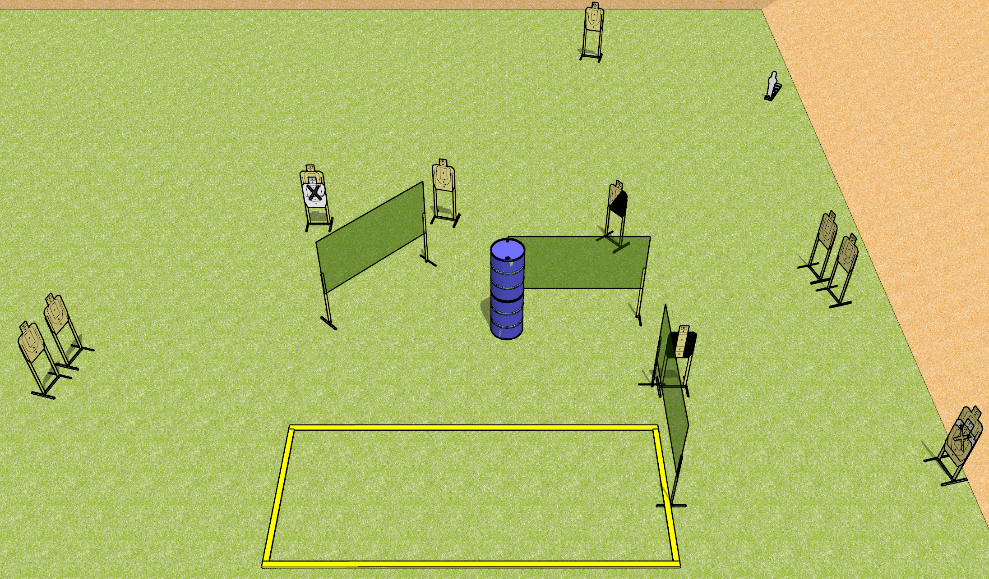
 | Dothan Gun Club – USPSA Match All Around Course Designer : Drew Coleman
Round Count 23 rounds 11 USPSA targets 1 mini popper
Equipment List 6 Wall feet Make shooting area 20x8 1 diagonal HC and 1 tux Far right target is stacked with NS

Slide 2
All Around
Written Stage Briefing
All Around is a 23 round, 115 point, Comstock course of fire. There are 11 USPSA targets and 1 mini popper. The best 2 hits on paper will score, and steel must fall to score. The start signal is audible.
Handgun start position is inside the shooting area, wrists below belt. Handgun is UNLOADED and holstered.
PCC start position is inside the shooting area, stock on belt. Carbine is UNLOADED.
On start signal, engage targets as they become available from within the shooting area.

